Slide 1
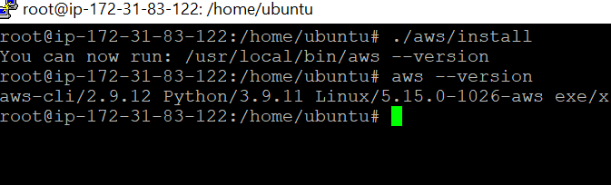
Installation & Configuration of AWS CLI
Firstly, we need to install AWS CLI tool on our server
-curl "https://awscli.amazonaws.com/awscli-exe-linux-x86_64.zip" -o "awscliv2.zip" apt install unzip unzip awscliv2.zip ./aws/install aws –version
aws configure

Slide 2
Installation of KUBECTL, EKSCTL, helm
Kubectl
-curl -LO "https://dl.k8s.io/release/$(curl -L -s https://dl.k8s.io/release/stable.txt)/bin/linux/amd64/kubectl" sudo install -o root -g root -m 0755 kubectl /usr/local/bin/kubectl
Eksctl
-curl --silent --location "https://github.com/weaveworks/eksctl/releases/latest/download/eksctl_$(uname -
s)_amd64.tar.gz" | tar xz -C /tmp sudo mv /tmp/eksctl /usr/local/bin
Helm
-curl https://baltocdn.com/helm/signing.asc | sudo apt-key add - sudo apt-get install apt-transport-https --yes echo "deb https://baltocdn.com/helm/stable/debian/ all main" | sudo tee /etc/apt/sources.list.d/helm-stable-
debian.list sudo apt-get update sudo apt-get install helm

Slide 3
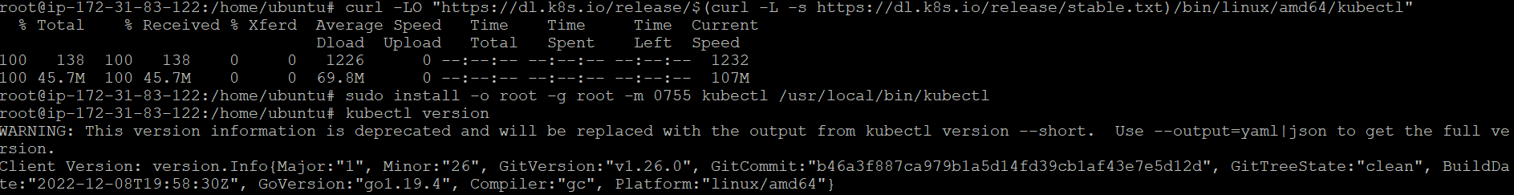
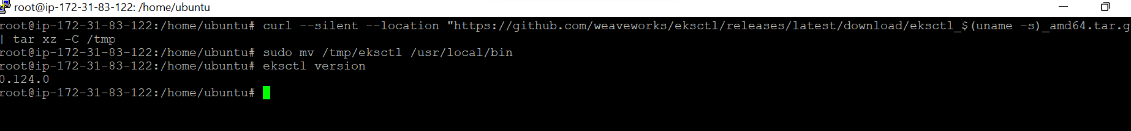
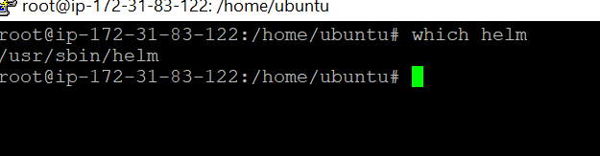

Slide 4
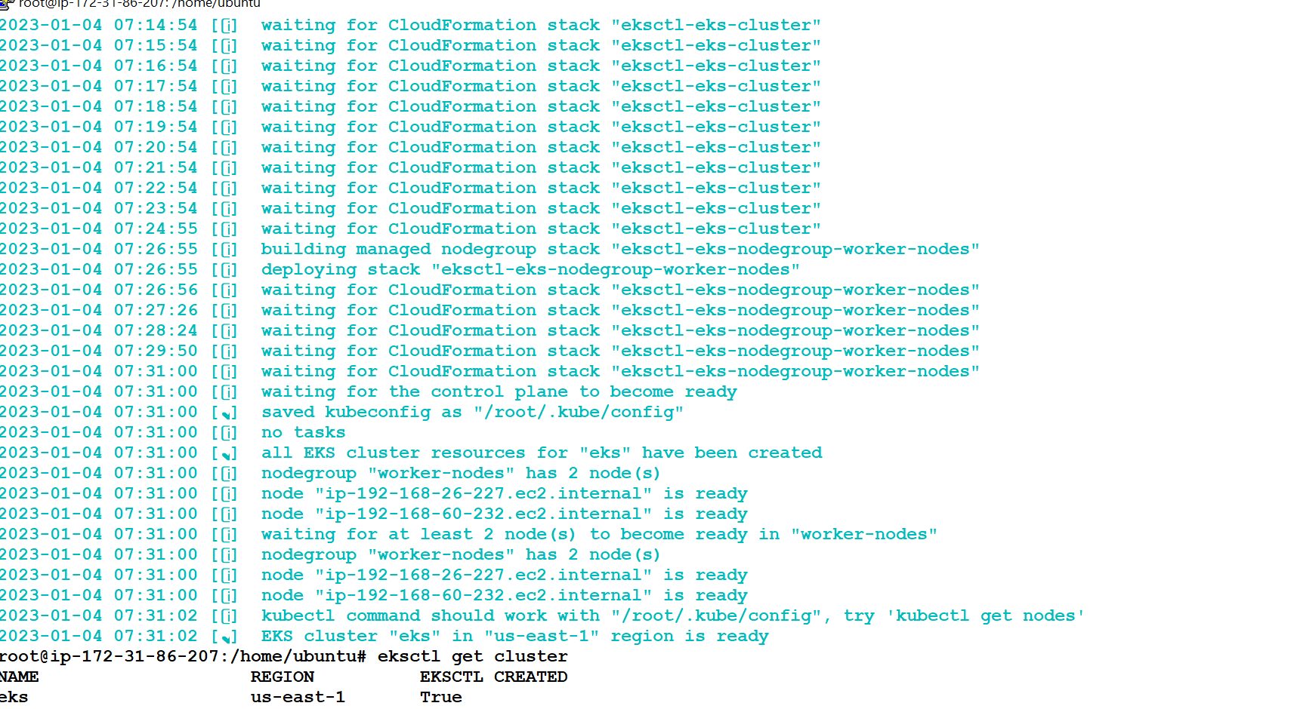
Cluster Creation
The next step is to create an EKS cluster on our server, following the steps the cluster can be created in our environment as per our requirement
- eksctl create cluster \ --name eks \ --version 1.24 \ --region us-east-1 \ --nodegroup-name worker- nodes \ --node-type t2.micro \ --nodes 1

Slide 5
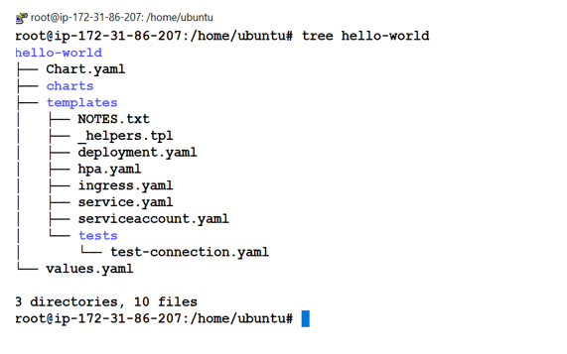
HELM Chart creation
The next step is to create a helm chart, following the command below –
helm create <Chart_Name>
To view the chart details –
helm show chart<Chart_Name>
helm list –a
To see the chart directory structure –
tree <Chart_Name>

Slide 6
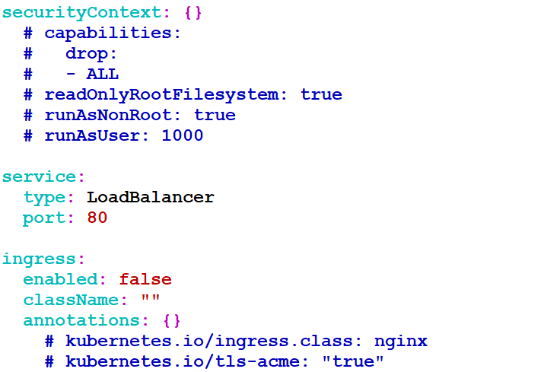
Helm Chart
Changing Service type as Load Balancer

Slide 7
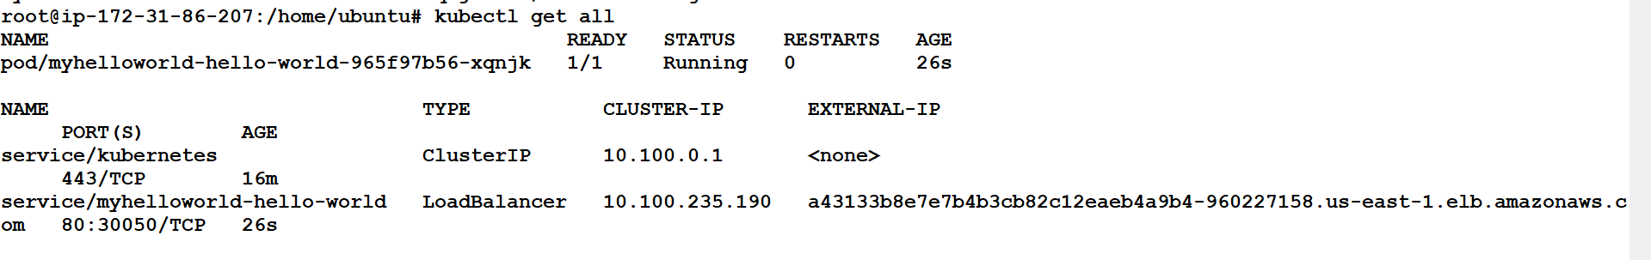
Installation of helm chart
The final step includes installation of the modified helm chart to deploy any particular release.
Our Application will be deployed, and we can view it through a web browser by hitting load balancer external IP
Command helm install <Release_Name> <Chart_Name>

Slide 8
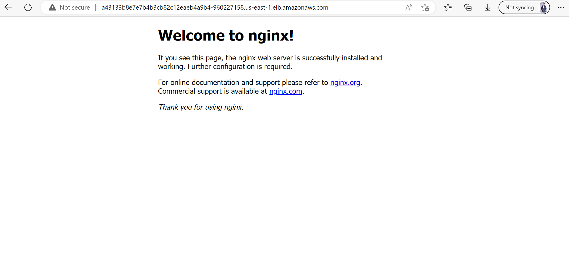
OUTPUT

Slide 9

Troubleshooting
We encountered multiple issues while implementing this POC
We have tried to include them all in the documentation here for future references

Slide 10
There was an error popping up while creating the EKS cluster , through EKSCTL command. Error consisted of the statement - 'The maximum number of VPCs has been reached.’ Solution: This error occurred because - When you create a cluster, EKSCTL itself creates a new Amazon Virtual Private Cloud (Amazon VPC) by default. So, the solution to this problem is to increase the quota of VPC's in that region , or to create the cluster in some other region where new VPC can be created. So, we fixed this issue by creating the cluster in some other region.

Slide 11
Faced error while naming the helm chart during chart creation Solution: Earlier, we were not following the naming convention as mentioned below- Naming convention - 'Chart names must be lower case letters and numbers. Words may be separated with dashes (-). Neither uppercase letters nor underscores can be used in chart names. Dots should not be used in chart names.’ Later , we followed the naming convention and the helm chart was created successfully.

Slide 12
Thank You

